Slide 1
电子社会学——凝聚态物理的风格和内容
吴从军
西湖大学理学院物理系
西湖大学物质科学公共实验平台 07/05/2021

Slide 2
What is condensed matter physics?
Old name: solid state physics (actually sounds better).
Unsophisticated, not cool --- the impression to the public.
Relation to daily life:
semiconductor physics -- electronic industry
solid, liquid, gas
metal, insulator, magnetism, superconductivity/superfluidity ..
soft condensed matter: polymer, protein, membrane, jamming, packing, avalanche….
Too diverse and hard to be articulate….

Slide 3
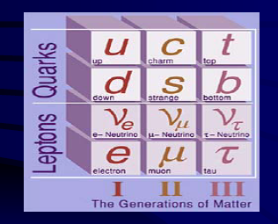
One-sentence introduction (I)
High energy: Physics at the smallest space-time scale.
Astrophysics: Physics at the largest space-time scale.
Microscopic structure of space-time, fundamental particles/interactions.
The birth, evolution and fate of the universe.

Slide 4
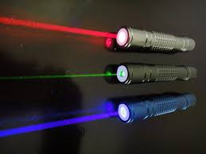
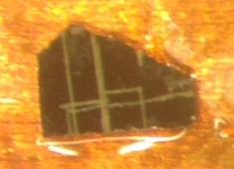
One-sentence Introduction (II)
Atom, Molecular, and Optical Physics: the most precise controllability – Laser, atomic clock
Condensed matter? Style and philosophy?
Is it fundamental, or, mostly an applied physics?

Slide 5
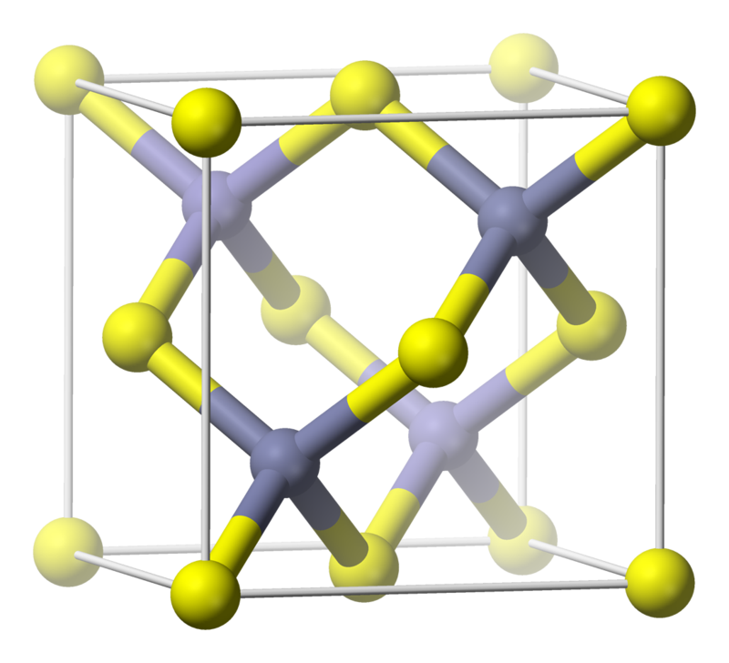
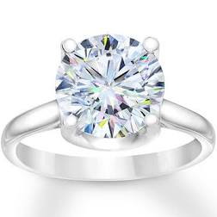
Pre-electron time
Discovery of ferromagnetism in ancient China and Greece.
Thales says that a stone has a soul because it causes movement to iron.
----De Anima, Aristotle (384-322 BC)
The magnetic stone attracts iron.
慈 石召铁
---- Guiguzi (鬼谷子), (4th century BC)
Crystals (group theory classification 19th century) :
7 crystal systems, 14 Bravais lattices, 32 point groups, 230 space groups.

Slide 6
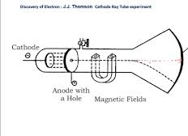
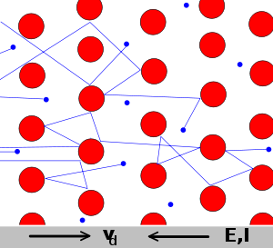
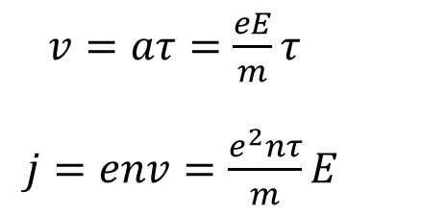
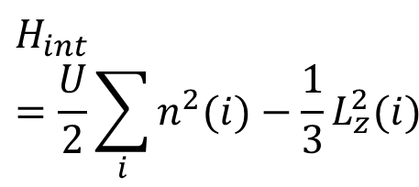
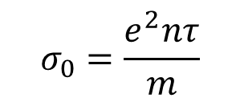
The birth: classic theory of electrons
1897 discovery of electron (J. J. Thomson)
$$H_{int}=\frac{U}{2}\sum_{i}{n_{ }^{2}(i)−\frac{1}{3}L_{z}^{2}(i)}$$
1900 Drude model -- the pioneer of condensed matter physics
Direct-current conductivity
$v=aτ=\frac{eE}{m}τ$
$j=env=\frac{e^{2}nτ}{m}E$
$$σ_{0}=\frac{e^{2}nτ}{m}$$

Slide 7
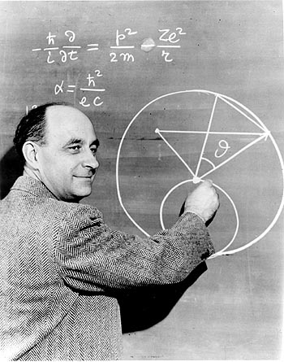

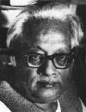
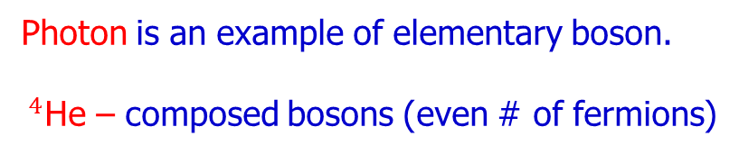
Indistinguishable particles: fermions and Bosons
Fermions: Pauli’s exclusion principle – two cannot occupy the same state.
Most matter particles are fermions (e.g. electrons).
E. Fermi
Bosons: one state can hold an arbitrary number of particles.
Photon is an example of elementary boson.
$^{4}$He – composed bosons (even # of fermions)
S. Bose
Notes:
In the following, we will first review some basic facts of magnetism, and superfluidity,
And provide our motivation for non-conventional generalization of them.

Slide 8
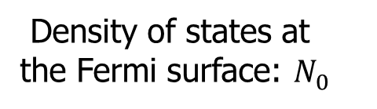
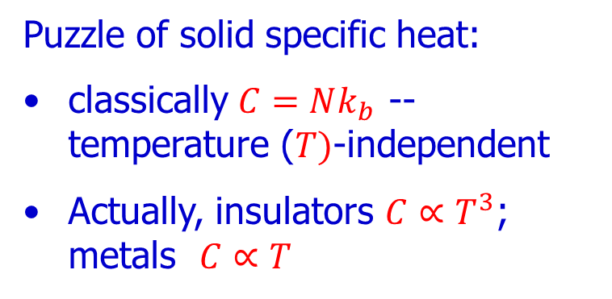
Childhood: Quantum Theory of Solids
Puzzle of solid specific heat:
classically $C=Nk_{b}$ -- temperature ($T)$-independent
Actually, insulators $C∝T^{3}$; metals $C∝T$
+
+
+
+
+
+
+
+
+
+
+
+
+
+
+
+
+
+
+
+
1912 Debye：phonon (boson)
quantization of lattice vibration
Fermi surface
1927 Sommerfeld: electron (fermion)
– quantum theory of metal
Density of states at the Fermi surface: $N_{0}^{ }$

Slide 9
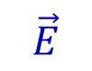
Why should there exist insulators?
Middle school knowledge:
Electrons are free in metals, but bound in insulators.
But how can electrons be bound?
$$\vec{E}$$
Classic picture: high barriers.
Quantum tunneling of electrons invalidates this picture.
Should insulators still be well-defined?
Notes:
The invention of QM in 20th century provides the principles to understand matter and materials.
For example, atoms form into molecules by chemical bonds. As for solids, there are essentially infinite number of atoms, hence, the real space bond picture does not work well. We need to go to the reciprocal momentum space. This is the essence of Bloch theory – electron state is a plane wave multiplied by a periodical function.
The concept of crystal and the Bloch theorem are the foundation of modern condensed matter physics. The importance of Bloch theorem is that it explains the existence of insulator, which is a consequence of QM. Imagine sending an electron wave into solids, the reflection wave from each lattice site interfere constructively if its momentum is half a reciprocal lattice vector. Then the incident and reflection waves need to be treated at equal footing. Their even and odd superpositions split in energy forming band gap. Then if a band is fully filled, it becomes an insulator. Without quantum mechanics we could not understand the very existence of insulator！

Slide 10
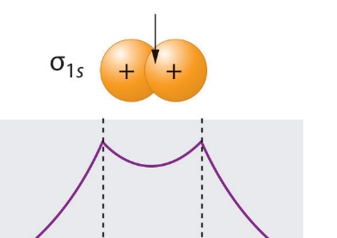
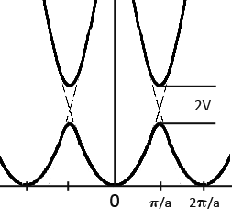
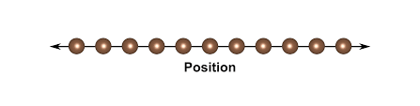
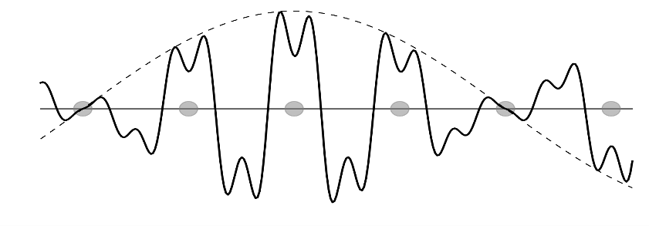
The Bloch theorem (1928)
Quantum theory of electrons in a lattice (non-interacting):
Bond (chemistry) → band (solid state physics).
Fourier transform: real to momentum space
gap due to matter wave interference!
Notes:
The invention of QM in 20th century provides the principles to understand matter and materials.
For example, atoms form into molecules by chemical bonds. As for solids, there are essentially infinite number of atoms, hence, the real space bond picture does not work well. We need to go to the reciprocal momentum space. This is the essence of Bloch theory – electron state is a plane wave multiplied by a periodical function.
The concept of crystal and the Bloch theorem are the foundation of modern condensed matter physics. The importance of Bloch theorem is that it explains the existence of insulator, which is a consequence of QM. Imagine sending an electron wave into solids, the reflection wave from each lattice site interfere constructively if its momentum is half a reciprocal lattice vector. Then the incident and reflection waves need to be treated at equal footing. Their even and odd superpositions split in energy forming band gap. Then if a band is fully filled, it becomes an insulator. Without quantum mechanics we could not understand the very existence of insulator！

Slide 11
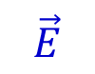
Insulator is a quantum consequence!
$$\vec{E}$$
Insulator as a consequence of Pauli’s exclusion principle
Fully occupied band → insulator
Notes:
The invention of QM in 20th century provides the principles to understand matter and materials.
For example, atoms form into molecules by chemical bonds. As for solids, there are essentially infinite number of atoms, hence, the real space bond picture does not work well. We need to go to the reciprocal momentum space. This is the essence of Bloch theory – electron state is a plane wave multiplied by a periodical function.
The concept of crystal and the Bloch theorem are the foundation of modern condensed matter physics. The importance of Bloch theorem is that it explains the existence of insulator, which is a consequence of QM. Imagine sending an electron wave into solids, the reflection wave from each lattice site interfere constructively if its momentum is half a reciprocal lattice vector. Then the incident and reflection waves need to be treated at equal footing. Their even and odd superpositions split in energy forming band gap. Then if a band is fully filled, it becomes an insulator. Without quantum mechanics we could not understand the very existence of insulator！

Slide 12
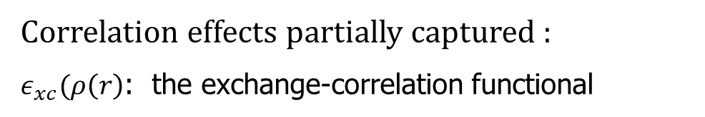
Kohn-Sham (沈吕九) -- Density functional theory
Successful in physics, material science, chemistry.
1998 Nobel Prize of Chemistry – work at UCSD physics.
Two difficulties: lattice effect and electron interactions.
→ Separate difficulties and approximate interactions as an averaged effect
(${−\frac{ℏ^{2}}{2m}∇^{2}+V\left(r\right)+∫d^{3}r^{′}\frac{e^{2}}{\left|r−r^{′}\right|}ρ\left(r^{′}\right)+\frac{δε_{xc}(ρ\left(r\right))}{δρ(r)}}^{ })ρ_{iσ}\left(r\right)=λ_{iσ}ρ_{iσ}\left(r\right)$.
Correlation effects partially captured :
$ε_{xc}(ρ\left(r\right)$: the exchange-correlation functional
Notes:
The invention of QM in 20th century provides the principles to understand matter and materials.
For example, atoms form into molecules by chemical bonds. As for solids, there are essentially infinite number of atoms, hence, the real space bond picture does not work well. We need to go to the reciprocal momentum space. This is the essence of Bloch theory – electron state is a plane wave multiplied by a periodical function.
The concept of crystal and the Bloch theorem are the foundation of modern condensed matter physics. The importance of Bloch theorem is that it explains the existence of insulator, which is a consequence of QM. Imagine sending an electron wave into solids, the reflection wave from each lattice site interfere constructively if its momentum is half a reciprocal lattice vector. Then the incident and reflection waves need to be treated at equal footing. Their even and odd superpositions split in energy forming band gap. Then if a band is fully filled, it becomes an insulator. Without quantum mechanics we could not understand the very existence of insulator！

Slide 13
Festkörperphysik ist eine Schmutzphysik – W. Pauli
Applications of quantum mechanics to messy systems?
Mundane particles -- electrons, ions, molecules...
Unsurprising interactions-- Coulomb, dipolar, van der Waals…
Physics of dirt!
Insulting!
Calm down. Let us take it as a stimulus toward critical thinking.
Yttrium Barium Copper Oxide (The first superconductor above the boiling point of Nitrogen)
Notes:
In the following, we will first review some basic facts of magnetism, and superfluidity,
And provide our motivation for non-conventional generalization of them.

Slide 14
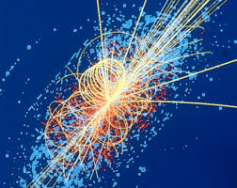
Outstanding problems? New principles?
Every sample is a universe, and the universe is just one sample.
To see a World in a Grain of Sand, And a Heaven in a Wild Flower,
一沙一世界， 一花一天国
Notes:
In the following, we will first review some basic facts of magnetism, and superfluidity,
And provide our motivation for non-conventional generalization of them.

Slide 15
A poet said, “The whole universe is in a glass of wine”
There are the things of physics:
the twisting liquid which evaporates depending on the wind and weather … and our imagination adds the atoms. The glass is a distillation of the earth’s rocks, and in its composition we see the secrets of the universe’s age, and the evolution of stars. ….
If our small minds, for some convenience, divide this glass of wine, this universe, into parts—physics, biology, geology, astronomy, psychology, and so on— remember that nature does not know it! So let us put it all back together, not forgetting ultimately what it is for.
…
Let it give us one more final pleasure: drink it and forget it all!
--- Feynman lectures of physics Volume (I) Chapter 3
Notes:
In the following, we will first review some basic facts of magnetism, and superfluidity,
And provide our motivation for non-conventional generalization of them.

Slide 16
Reductionism: Divide and Conquer
Democritus (460-370BC): The atomic hypothesis.
Success: standard model and beyond
Atom → nucleus and electron → proton, neutron → quark → superstring
… reductionism is a sense of hierarchy, that some truths are less fundamental than others to which they may be reduced… -- S. Weinberg
Theory of everything or nothing?
Hopeless.
Notes:
In the following, we will first review some basic facts of magnetism, and superfluidity,
And provide our motivation for non-conventional generalization of them.

Slide 17
Notes:
In the following, we will first review some basic facts of magnetism, and superfluidity,
And provide our motivation for non-conventional generalization of them.

Slide 18
Condensed Matter: Sociology of Particles
Key features:
Huge amount of particles: 10²² per cm³ (electrons, molecules) of matter!
Strong interactions!
Organization leads to success! -- New states of matter
human: crowd v. s. army
$H_{2}O$ molecules: vapor, water, and ice.
Social behavior of particles and the underlying organizing principles.
Particles (electrons) as “citizens” of a big society
Notes:
In the following, we will first review some basic facts of magnetism, and superfluidity,
And provide our motivation for non-conventional generalization of them.

Slide 19
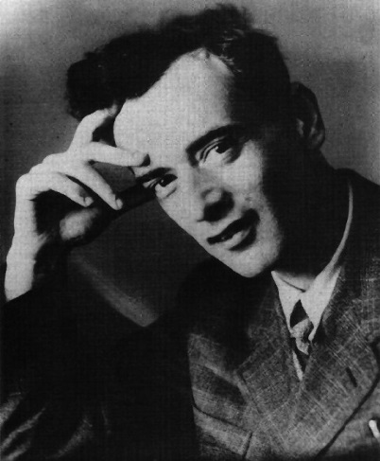
More is different! – P. W. Anderson
Quantitative → qualitative changes.
“The main fallacy in this kind of thinking is that the reductionist hypothesis does not by any means imply a "constructionist" one: the ability to reduce everything to simple fundamental laws does NOT imply the ability to start from those laws and reconstruct the universe”.
L. D. Landau
P. W. Anderson Science Vol. 177, 393 (1972).
Notes:
In the following, we will first review some basic facts of magnetism, and superfluidity,
And provide our motivation for non-conventional generalization of them.

Slide 20
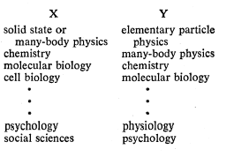
More is different!
“The behavior of large and complex aggregates of elementary particles, it turns out, is not to be understood in terms of a simple extrapolation of the properties of a few particles.
“Instead, at each level of complexity entirely new properties appear, and the understanding of the new behaviors requires research which I think is as fundamental in its nature as any other”.
Notes:
In the following, we will first review some basic facts of magnetism, and superfluidity,
And provide our motivation for non-conventional generalization of them.

Slide 21
Analogy: medical science v.s. sociology
The functions of human-body organs are governed by medical laws, and the laws of a society certainly obey the medical laws.
Politicians should respect the fact that humans need to eat to survive, otherwise, the society will not run. But this is insufficient to run a society.
Social sciences should be consistent with the medical science, but cannot be reduced to, or, be derived from, the medical science.
Summarize experimental facts, propose new physical laws, and discover the underlying principles.
Notes:
In the following, we will first review some basic facts of magnetism, and superfluidity,
And provide our motivation for non-conventional generalization of them.

Slide 22
What are outstanding problems?
To identify itself, condensed matter needs its own outstanding problems:
Superconductivity/Superfluidity
Magnetism
Topological physics
Dynamics and correlation
Bio-process, life, consciousness
Methodological and conceptual feedbacks to high energy, AMO, astrophysics, even other branches of sciences.
Notes:
In the following, we will first review some basic facts of magnetism, and superfluidity,
And provide our motivation for non-conventional generalization of them.

Slide 23
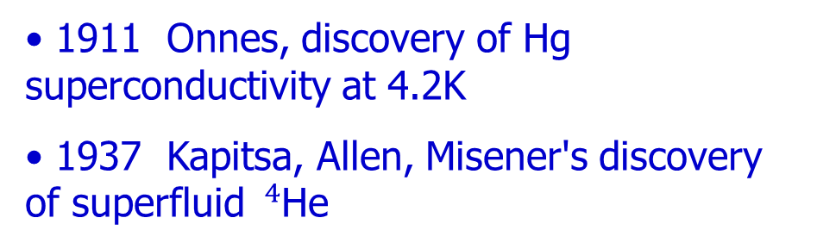
Superfluidity/Superconductivity
1911 Onnes, discovery of Hg superconductivity at 4.2K
1937 Kapitsa, Allen, Misener's discovery of superfluid $^{4}$He
Feynman could not solve it!
“The story of Feynman’s epic battle with superconductivity is a little-known chapter in his scientific career. As it turned out, Feynman was the loser in that struggle…….”
Zero resistance
Notes:
In the following, we will first review some basic facts of magnetism, and superfluidity,
And provide our motivation for non-conventional generalization of them.

Slide 24
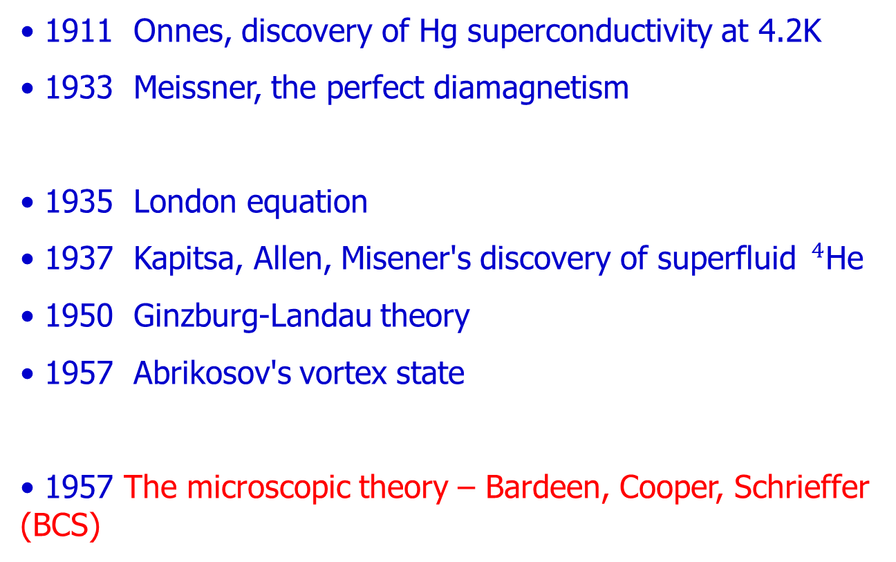
Superfluidity/Superconductivity – pre BCS
1911 Onnes, discovery of Hg superconductivity at 4.2K
1933 Meissner, the perfect diamagnetism
1935 London equation
1937 Kapitsa, Allen, Misener's discovery of superfluid $^{4}$He
1950 Ginzburg-Landau theory
1957 Abrikosov's vortex state
1957 The microscopic theory – Bardeen, Cooper, Schrieffer (BCS)
Notes:
In the following, we will first review some basic facts of magnetism, and superfluidity,
And provide our motivation for non-conventional generalization of them.

Slide 25
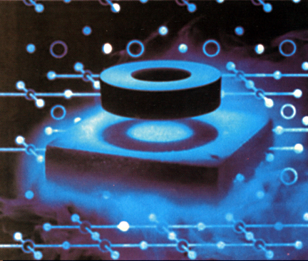

New concepts needed!
Superconductor is NOT an ideal conductor.
Best conductors (Ag, Au) do not superconduct.
Good superconductors are often bad conductors above Tc.
Meissner effect – complete diamagnetism
magnetic field (B) cannot penetrate the bulk superconductor
Notes:
In the following, we will first review some basic facts of magnetism, and superfluidity,
And provide our motivation for non-conventional generalization of them.

Slide 26
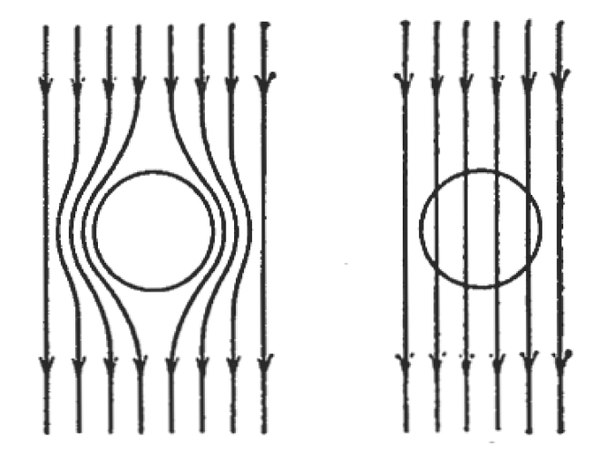
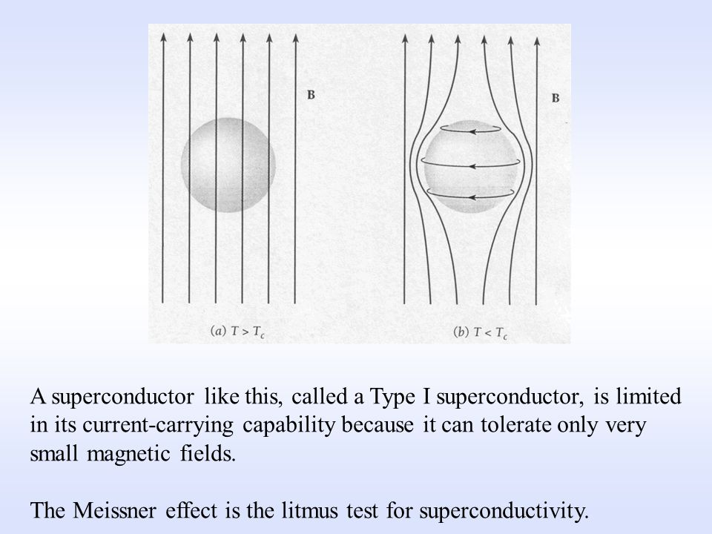
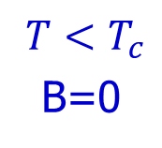
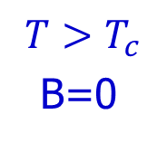
Ideal conductor v.s superconductor
Apply B-field
$${ T>T}_{c}^{ }$$
B=0
$${ T<T}_{c}^{ }$$
B=0
Lentz’s law: Screening currents develop in both cases to prevent the B-field to penetrate inside.
Screening currents decays → B-field enters the bulk

Slide 27
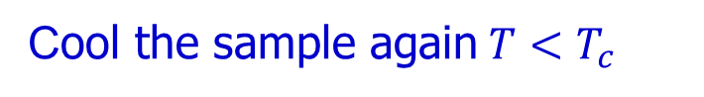
Meissner effect: beyond Lenz law
Cool the sample again${ T<T}_{c}^{ }$
Superconductor: B-field repelled again; independent on history;
Ideal conductor: maintain its history
Note that the screening current is against the direction by the Lentz law (pointed by J. Hirsch).

Slide 28
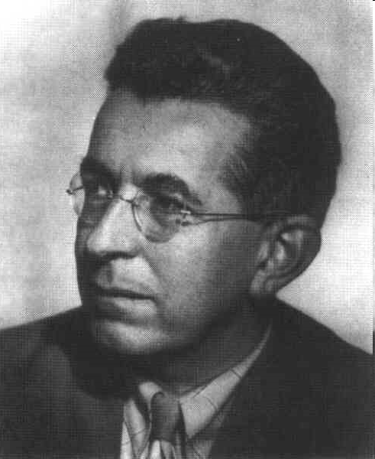
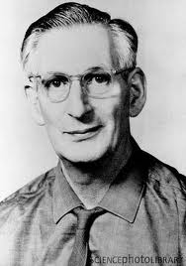
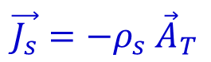
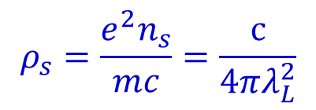
E&M responses: The London equation
$\vec{A}= {\vec{A}}_{T}+{\vec{A}}_{L}, ∇⋅{\vec{A}}_{T}=0, ∇×{\vec{A}}_{L}=0$
Response to the vector potential A:
$\vec{J_{s}}=−ρ_{s} {\vec{A}}_{T}$
Superfluid density:
$$ρ_{s}^{ }=\frac{e^{2}n_{s}}{mc}=\frac{c}{4πλ_{L}^{2}}$$
Penetration depth

Slide 29

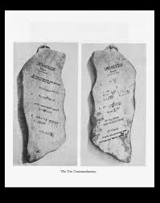
Who is Lev Landau (1908-1968)?
Ten Commandments
1927, Density matrix;
1930, Landau diamagnetism;
1935, Dynamics of ferromagnets (with E. Lifshitz);
1937, Theory of phase transitions (1937);
1937, Intermediate state of superconductors;
1937, Statistical theory of nuclei (1937);
1941, Theory of superfluidity (1941);
1954, Renormalization of electron charge in quantum electrodynamics (1954, with A. Abrikosov and I. Khalatnikov);
1956, Theory of Fermi Liquid;
1957,Two-component neutrino theory.

Slide 30
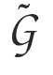

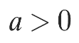
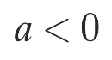


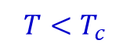
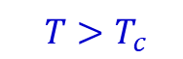
New concept: Landau theory of phase transiton
Order parameter and spontaneous symmetry breaking
symmetric disordered phase
Symm. Breaking, ordered phase
$${ T>T}_{c}^{ }$$
$${ T<T}_{c}^{ }$$

Slide 31
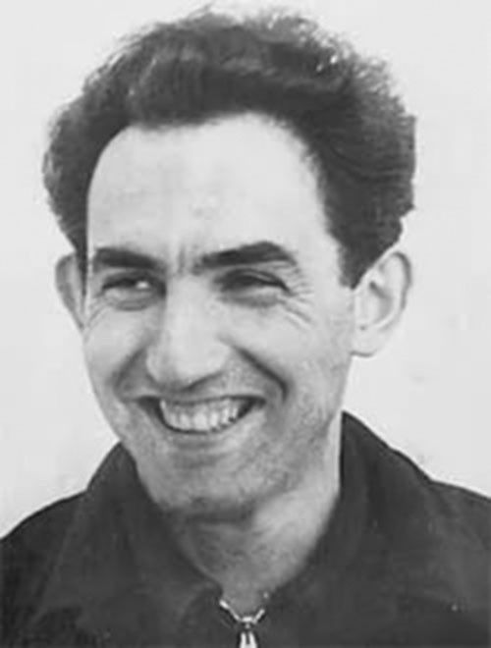
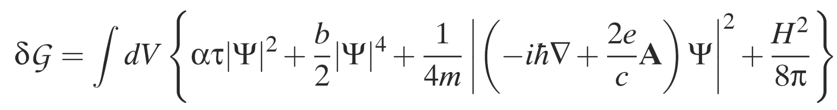

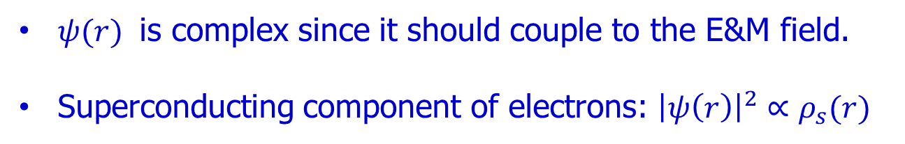
Ginzburg-Landau theory for superconductivity
How to design the superconducting order parameter ${ψ(r)}^{ }$without knowing the microscopic theory?
c.f. How did Mendeleev design the periodical table without knowing quantum mechanics?
${ψ(r)}^{ }$ is complex since it should couple to the E&M field.
Superconducting component of electrons: ${{\left|ψ\left(r\right)\right|}^{2}∝ρ_{s}(r)}^{ }$

Slide 32
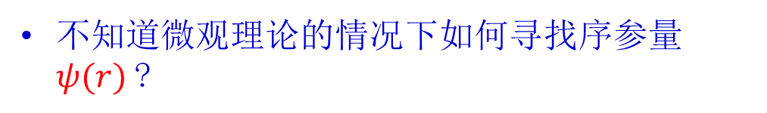
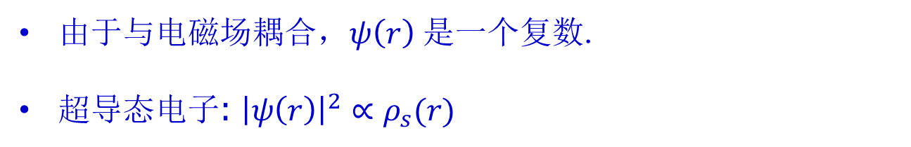
Ginzburg-Landau 理论
不知道微观理论的情况下如何寻找序参量 ${ψ(r)}^{ }$?
c.f.门捷列夫不知道量子力学的情况下如何发现元素周期表?
由于与电磁场耦合，$ψ\left(r\right)$是一个复数.
超导态电子: ${{\left|ψ\left(r\right)\right|}^{2}∝ρ_{s}(r)}^{ }$

Slide 33
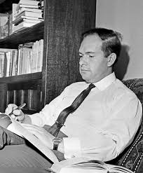
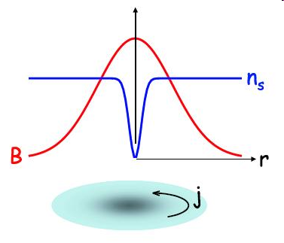



Topological defect -- Abrikosov vortex state
Coherence length $ξ^{ }$→ condensation energy
Penetration depth $λ_{L}^{ }$→ magnetic energy
$${κ=λ_{L}/ξ}^{ }>\frac{1}{\sqrt{2}}$$
magnetic energy wins, and B-field enters.
Flux quantization:

Slide 34


拓扑缺陷-Abrikosov 涡旋态
相干长度 $ξ^{ }$→ 凝聚能
伦敦穿透深度 $λ_{L}^{ }$→ 磁能
$${κ=λ_{L}/ξ}^{ }>\frac{1}{\sqrt{2}}$$
凝聚能与磁能竞争，磁能压制凝聚能，磁场$B$ 进入超导.
磁通量子化:

Slide 35



Superfluidity of ⁴He
discovered by P. Kapitsa, J. F. Allen, and D. Misener in 1937.
The disappearance of viscosity
Superfluid He can "creep" along surfaces in order to find its own level - after a short while, the levels in the two containers will equalize.
Notes:
In the following, we will first review some basic facts of magnetism, and superfluidity,
And provide our motivation for non-conventional generalization of them.

Slide 36
⁴He 超流
P. Kapitsa, J. F. Allen, and D. Misener (1937).
无粘性
喷泉效应：超流液氦会沿着表面爬升，不久两边会达到平衡.
Notes:
In the following, we will first review some basic facts of magnetism, and superfluidity,
And provide our motivation for non-conventional generalization of them.

Slide 37

Superfluidity: Bose-Einstein Condensation (BEC)
F. London: A macroscopic fraction of ⁴He atoms (bosons) form a coherent condensate (BEC).
$Ψ\left(r_{1},r_{2},r_{3},…\right)=φ_{0}\left(r_{1} \right)φ_{0}\left(r_{2} \right)φ_{0}\left(r_{3} \right)$……
Condensate develops rigidity
Impurities cannot scatter a moving condensate
c.f. Small bumps on a road cannot stop a marching army.
Notes:
In the following, we will first review some basic facts of magnetism, and superfluidity,
And provide our motivation for non-conventional generalization of them.

Slide 38
超流: 玻色爱因斯坦凝聚（BEC）
伦敦: ⁴He（玻色子）原子宏观部分形成相干凝聚态 (BEC).
$Ψ\left(r_{1},r_{2},r_{3},…\right)=φ_{0}\left(r_{1} \right)φ_{0}\left(r_{2} \right)φ_{0}\left(r_{3} \right)$……
凝聚态刚性（rigidity）
凝聚态不会被杂质散射
c.f. 小颠簸不能阻止大进军。
Notes:
In the following, we will first review some basic facts of magnetism, and superfluidity,
And provide our motivation for non-conventional generalization of them.

Slide 39





BCS theory: Cooper Pairing of fermions
J. Bardeen L. N. Cooper J. R. Schrieffer
Electrons cannot directly condense.
Flux quanta $Φ=\frac{hc}{e^{∗}}, e^{∗}=2e,$
→ pairing into bosons, then condense.
Notes:
In the following, we will first review some basic facts of magnetism, and superfluidity,
And provide our motivation for non-conventional generalization of them.

Slide 40

BCS理论：费米子Cooper对
J. Bardeen L. N. Cooper J. R. Schrieffer
电子不能直接凝聚.
磁通 $Φ=\frac{hc}{e^{∗}}, e^{∗}=2e,$
→ 两个电子配对成Cooper对形成玻色子，有效电荷为$2e，$然后发生凝聚.
Notes:
In the following, we will first review some basic facts of magnetism, and superfluidity,
And provide our motivation for non-conventional generalization of them.

Slide 41
The gluing force – electron-phonon interaction
Coulomb repulsion! How come to pair with someone you dislike?
+
+
+
+
+
+
+
+
+
+
The media helps: the positively charged and vibrating ions!
+
+
+
+
+
+
+
+
+
+
An electron attracts the ions, creating temporary positive charge excess, and then quickly flies away
The lattice polarization will remain for a while, and attracts another electron.
Notes:
In the following, we will first review some basic facts of magnetism, and superfluidity,
And provide our motivation for non-conventional generalization of them.

Slide 42
电声子相互作用
库伦排斥! 如何把两个互不喜欢的人配对在一起?
+
+
+
+
+
+
+
+
+
+
媒介来帮忙: 正电荷和振动的离子!
+
+
+
+
+
+
+
+
+
+
一个电子吸引离子，形成暂时的正电荷过剩，然后迅速飞走
晶格极化将保持一段时间，并吸引另一个电子.
Notes:
In the following, we will first review some basic facts of magnetism, and superfluidity,
And provide our motivation for non-conventional generalization of them.

Slide 43

Cooper Pair: 2-electron problem
Bound state at an infinitesimal attraction
Notes:
In the following, we will first review some basic facts of magnetism, and superfluidity,
And provide our motivation for non-conventional generalization of them.

Slide 44




Why did Feynman fail?
Superconducting ground state are reorganized!
Non-perturbative nature!
$$T_{c}∝e^{−\frac{1}{g}}, g=NV/2$$
Feynman diagrams
$T_{c}$ cannot be expanded as power series starting from normal state!
$$T_{c}≠c_{1}g+c_{2}g^{2}+c_{3}g^{3}+….$$
Notes:
In the following, we will first review some basic facts of magnetism, and superfluidity,
And provide our motivation for non-conventional generalization of them.

Slide 45


Condensation of Cooper pairs: from 2 to ${10}^{20}$
Wavefunction of a single pair
$${φ_{c}(r_{1},r_{2})}^{ }$$
All electrons close to the Fermi surface form macroscopic number of pairs Cooper pairs.
Cooper pairs condense building up phase rigidity
$$Ψ\left(r_{1},r_{2},r_{3},r_{4},…\right)=A[φ_{c}\left(r_{1},r_{2}\right)φ_{c}\left(r_{3},r_{4}\right)…]$$
Notes:
In the following, we will first review some basic facts of magnetism, and superfluidity,
And provide our motivation for non-conventional generalization of them.

Slide 46


Superfluidity/Superconductivity – post BCS
1962 Josephson effect
1962 Anderson-Higgs mechanism
1971 $^{3}$He superfluidity
1986 Bednorz and Mueller's discovery of high $T_{c}$ superconductivity
1995 Observation of atomic BEC
2006 Iron-based superconductivity
2010's Topological superconductivity, Majorana fermion
2010's Superconductivity of hydrides, $H_{2}S,LaH_{10}$
Notes:
In the following, we will first review some basic facts of magnetism, and superfluidity,
And provide our motivation for non-conventional generalization of them.

Slide 47

Theory for high Tc superconductivity ?
One of the most challenging problem in modern physics.
People have made considerable progress but still do not satisfying theories.
Intrinsically strong coupling problem.
Complicated structures;
Many competing phases;
Your contribution? Another Nobel prize?
Notes:
In the following, we will first review some basic facts of magnetism, and superfluidity,
And provide our motivation for non-conventional generalization of them.

Slide 48



Laser Cooling and Evaporative Cooling
BEC of alkali atoms: Li, Na, K, Rb, Cs, etc.
Optical molasses. Cool to 10⁻⁵ K. Still not cool enough.
Evaporative cooling → 10⁻⁶ K – the lowest temperatures in the university are in labs.

Slide 49




Bose-Einstein condensation with cold atoms
E. A. Cornell
W. Ketterle
M. H. Anderson et al., Science 269, 198 (1995)
C. E. Wieman

Slide 50
Tips to be a good condensed matter physicist
See electrons: Pretend ourselves as electrons and think how we should behave.
Pay attention to real physics rather than formal techniques.
Trial wavefunctions solve problems – BCS, Laughlin
Field theory is useful, but do not addict to it.
Condensed matter models are NOT derived! They are constructed!
Notes:
In the following, we will first review some basic facts of magnetism, and superfluidity,
And provide our motivation for non-conventional generalization of them.

Slide 51
Two criteria for judging a theory work.
beauty
reality
mathematically clean and elegant
relevancy to experiment.
If both criteria are satisfied, it is a great work.
If only one is satisfied, it is still a nice work.
But never do a work which is mathematically ugly and irrelevant to experiments.
Notes:
This is the summary of the interaction part. We have explained what is the
unconventional magnetism. It is an analogy of the USC in the context
of magnetism.
We have showed the Umagnetic phase can be classified into isotropic phase and
Anisotropic phase. The isotropic phase gives rise a new mechanism for dynamic
Generation of SO from many body interactions. The anisotropic
phase is an example of electron liquid crystal phase with spin.

Slide 52
Four different types of physicists---by L. Landau
sharp mind, strong knowledge background;
Einstein, Bohr, etc
sharp mind, weak background
Landau put himself in this category
slow mind, strong background
Most successful physicists
slow mind, weak background
Genius is one percent inspiration and 99 percent perspiration.
-----T. A. Edison
Notes:
This is the summary of the interaction part. We have explained what is the
unconventional magnetism. It is an analogy of the USC in the context
of magnetism.
We have showed the Umagnetic phase can be classified into isotropic phase and
Anisotropic phase. The isotropic phase gives rise a new mechanism for dynamic
Generation of SO from many body interactions. The anisotropic
phase is an example of electron liquid crystal phase with spin.

Slide 53
To see a World in a Grain of Sand, And a Heaven in a Wild Flower,
一沙一世界， 一花一天国
Hold Infinity in the palm of your hand, And Eternity in an hour
君掌盛无边， 刹那即永恒
--- “Auguries of Innocence”, William Blake
Condensed matter physics is fundamental physics pursuing beauty and truth, fully of opportunities for young people.

Slide 55






Condensation of Cooper pairs: from 2 to ${10}^{23}$
All electrons close to the Fermi surface form Cooper pairs.
$$k^{ }$$
Different Cooper pairs (${k↑, −k↓}^{ }$) scatter into each other.
$${k′}^{ }$$
They share the same phase information, and build up phase coherence
$${−k′}^{ }$$
$${−k}^{ }$$
$${φ(r_{1},r_{2})}^{ }$$
Notes:
In the following, we will first review some basic facts of magnetism, and superfluidity,
And provide our motivation for non-conventional generalization of them.

Slide 56


From 2 to ${10}^{23}$-- Condensation of Cooper pairs
$${φ(r_{1},r_{2})}^{ }$$
Different Cooper pairs (${k↑, −k↓}^{ }$) share the same condensate wavefunction ${χ(k)}^{ }$ → phase coherence
The BCS gap equati:
Notes:
In the following, we will first review some basic facts of magnetism, and superfluidity,
And provide our motivation for non-conventional generalization of them.

Slide 57


The gluing force – electron phonon interaction
e-e interaction: instantaneous
+
+
+
+
+
+
+
+
+
e-ph screening: retarded
+
+
+
+
+
+
+
+
+
+
+
$Ω_{p}^{ }$: Debye frequency.
$$V_{eff}^{ }\left(q,ω\right)=\frac{4πe^{2}{/q}^{2}}{ε(q,ω)}=V_{sc}(q)(1+\frac{ω_{ph}^{2}\left(q\right)}{ω^{2}−ω_{ph}^{2}\left(q\right) })$$
Effective attraction at ${ω<ω_{ph}^{2}(q)}^{ }$-- H. Fröhlich
Electron polarize the lattice, flies away, and the polarization attracts another electron.
Notes:
In the following, we will first review some basic facts of magnetism, and superfluidity,
And provide our motivation for non-conventional generalization of them.

